Slide 1


ASSET TRACKING SOLUTION WITH BLE-ENABLED TAGS
BY
SHUBHAM KUMAR SAURAV(18246)
AMIT KUMAR MISTRI(17937)
GUIDED BY
PROF. JOY KURI
PROF. HARESH DAGALE

Slide 2
M.Tech Project Demo Report
Date: 17/06/2022
Time: 2:00 P.M.
Demo 1: VEHICLE MONITORING SYSTEM
One of the reviewers, Prof. Shyan G Srinivasa was present with Amit kumar Mistri and Prof. Haresh Dagale in the Embedded system lab-1, to view the vehicle OBD parameters in the MongoDB charts
The other reviewer , Prof. Utsav Bannerjee was present in the car along with Shubham kumar Saurav, to view the OBD parameters in the serial monitor. All the parameter readings received in the Master Gateway, were printed on the Laptop screen and displayed. Also the charts for these parameters were displayed to the reviewer.
Demo 2: ASSET SECURING SYSTEM
Both the reviewers were present in the lab, and the asset securing system was explained and working demo was shown

Slide 3
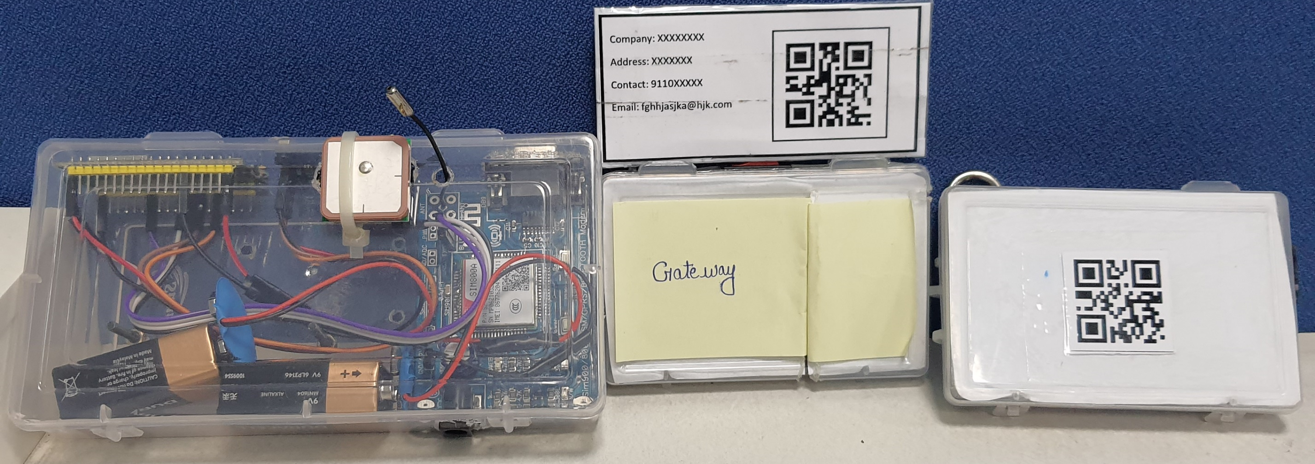
Hardware
Authorization Card
MASTER GATEWAY
BLE GATEWAY
TAG

Slide 4
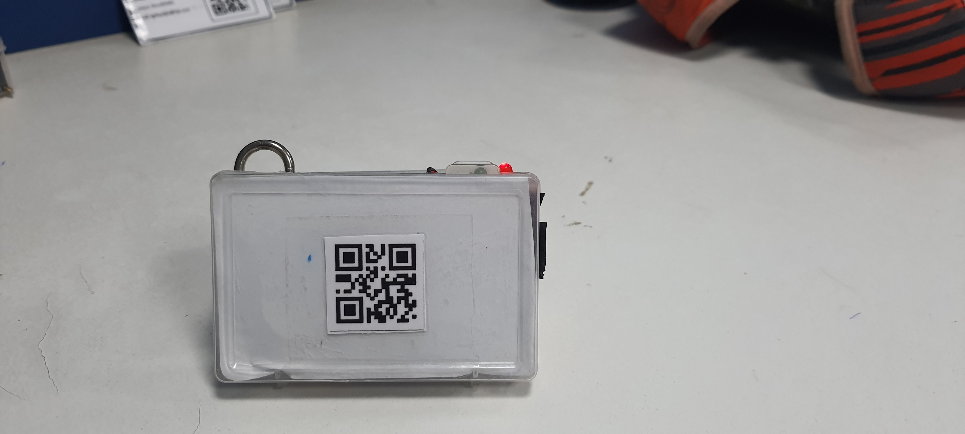
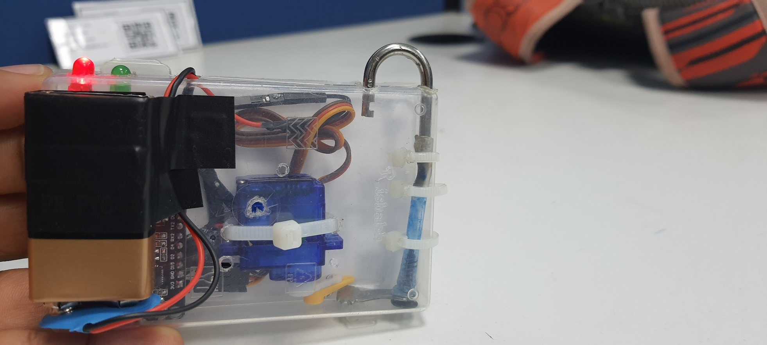
TAG
Latch of lock
QR Code of Tag
Latch of lock
Status LEDs
Locking Mechanism
Exterior View
Interior View

Slide 5
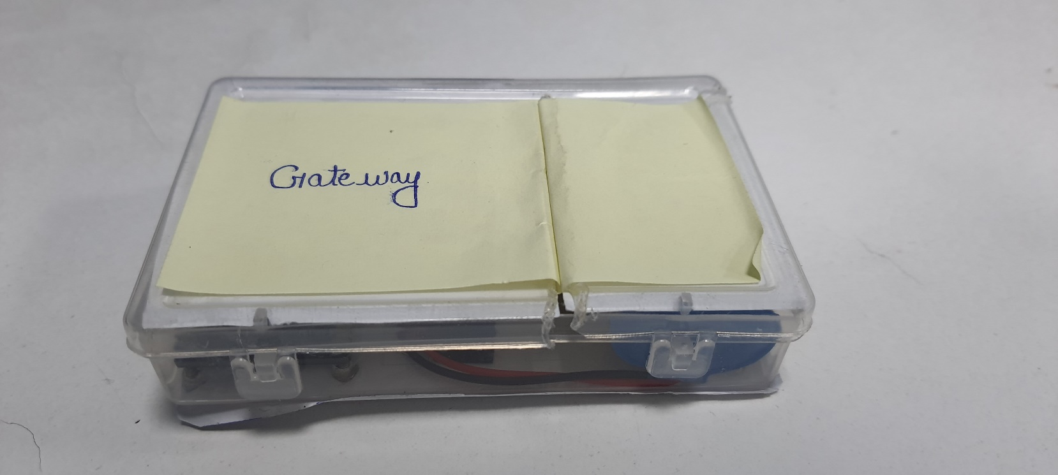

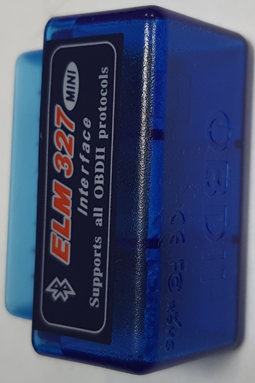
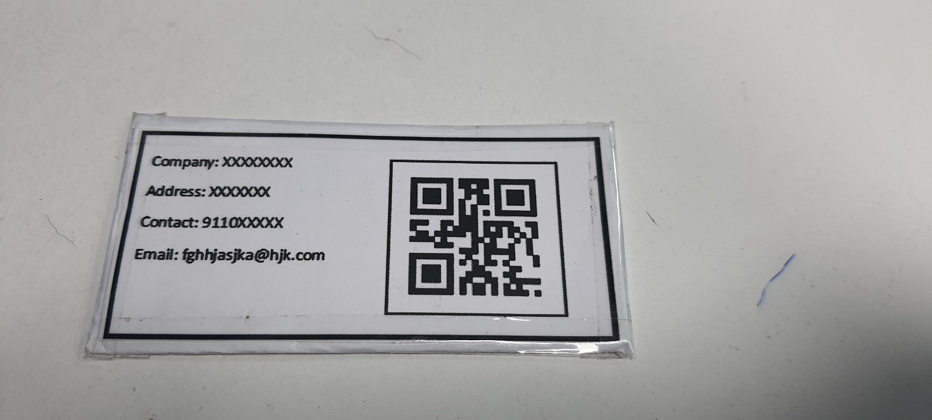
GATEWAY
Exterior View
Interior View
Authorization Card
OBD Scanner

Slide 6
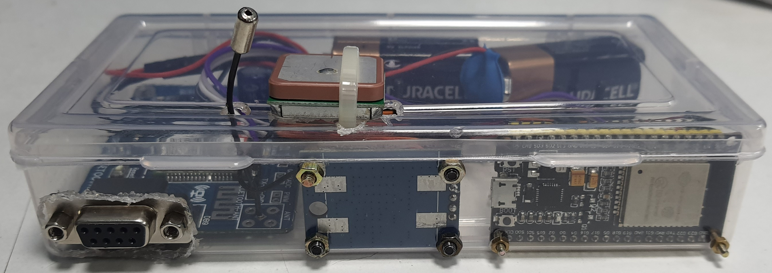
MASTER GATEWAY
GSM Module
GPS Module

Slide 7
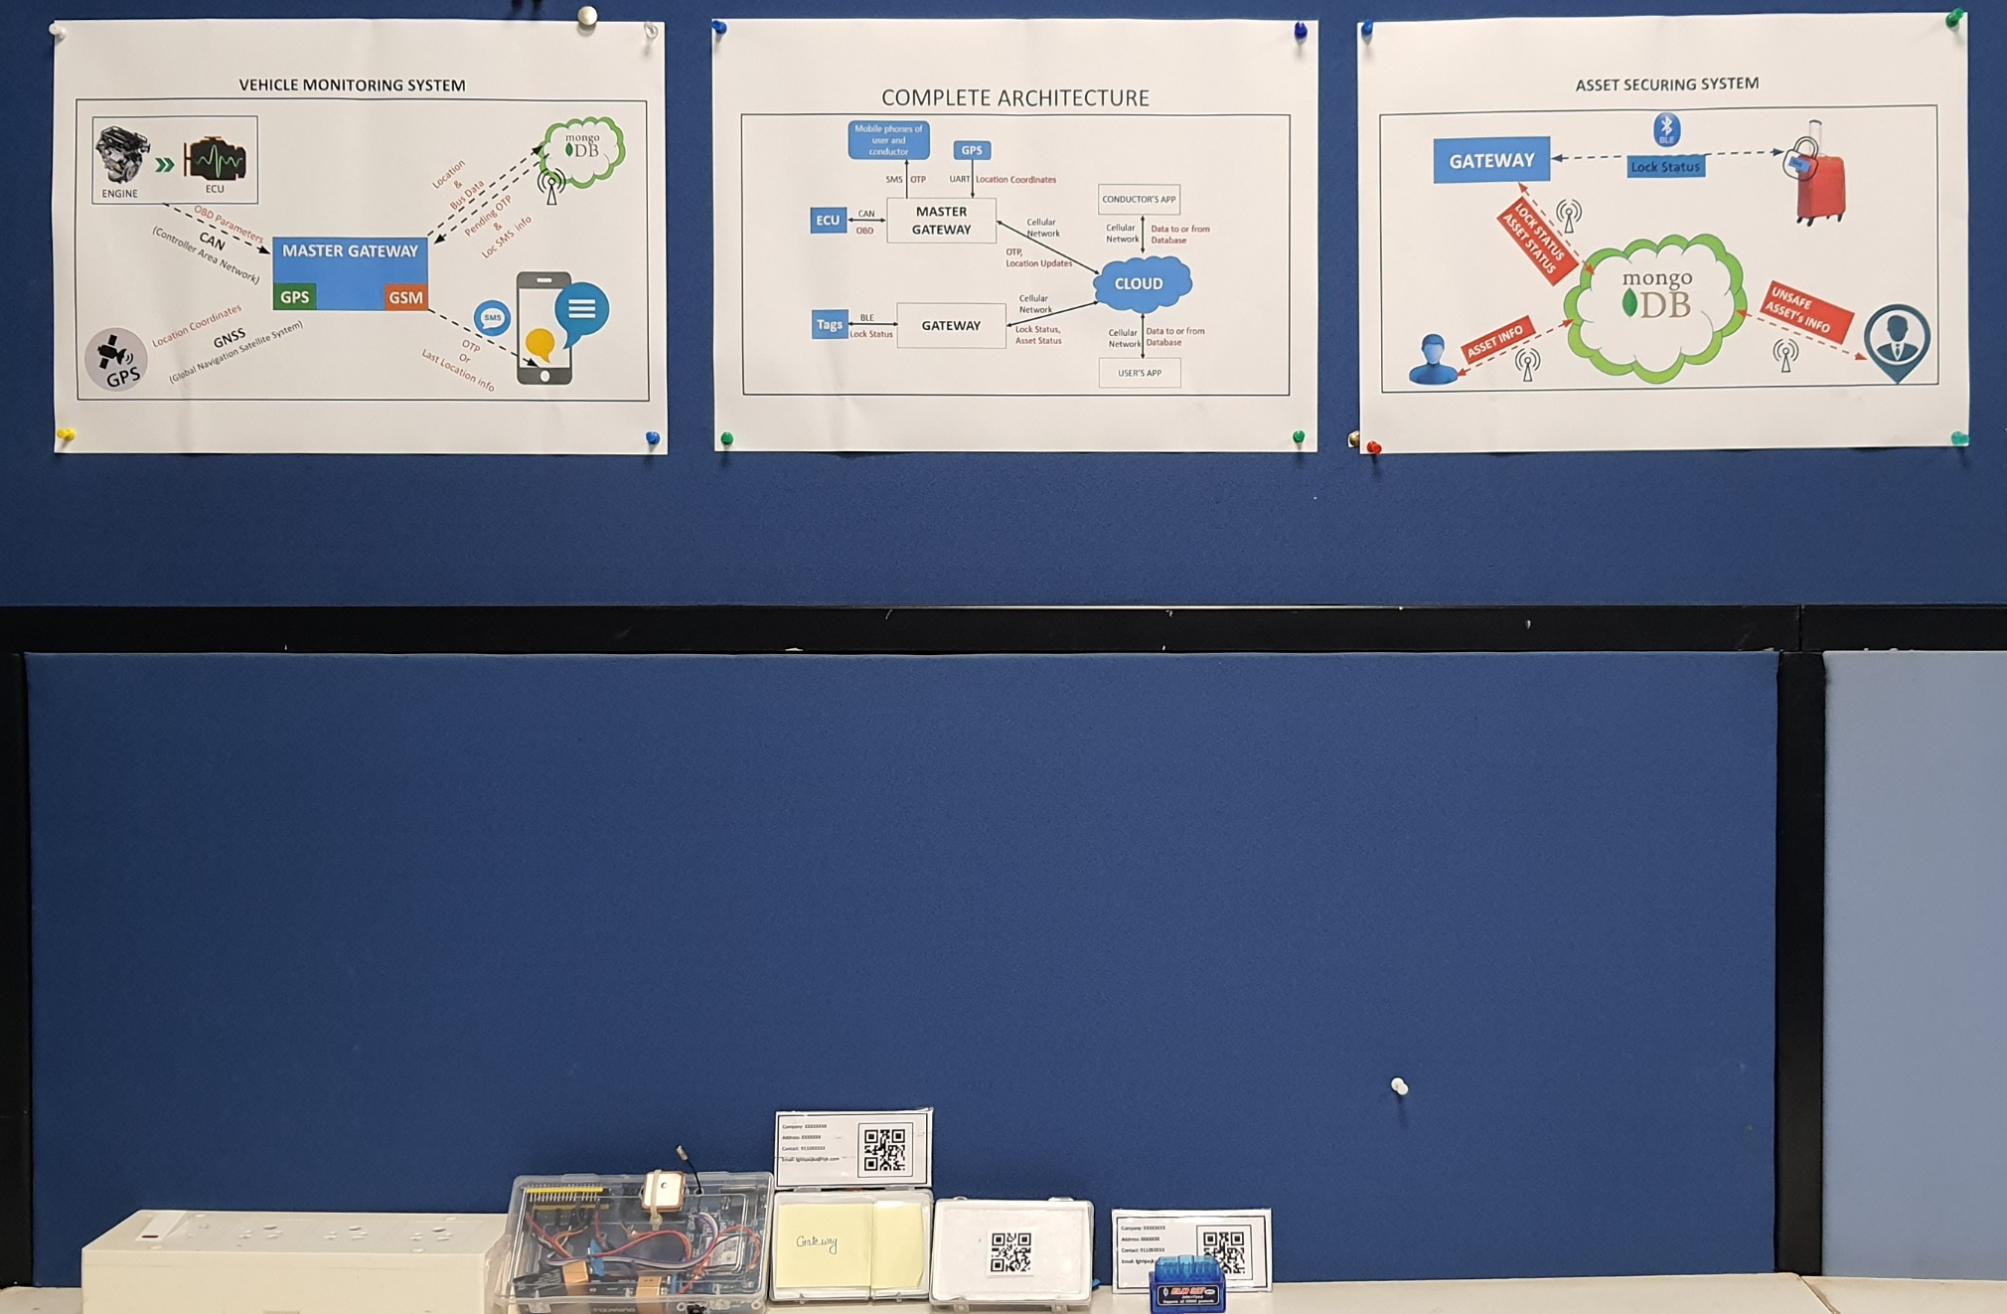
Complete Setup

Slide 8
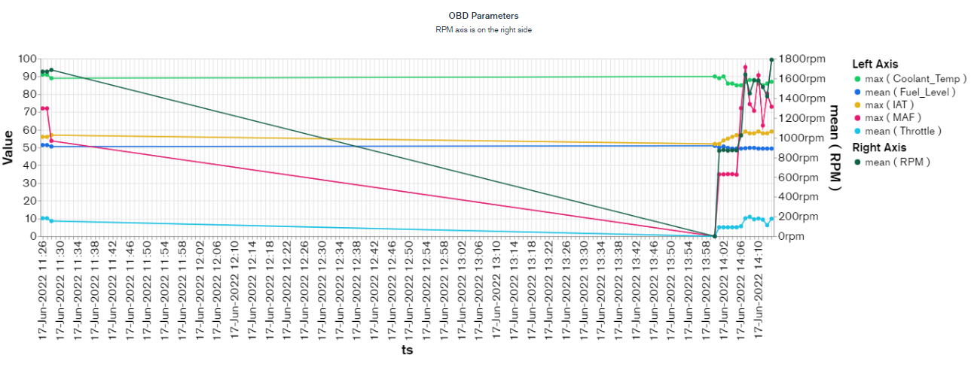
Chart for OBD parameters
Keeps updating automatically in every 30 seconds

Slide 9
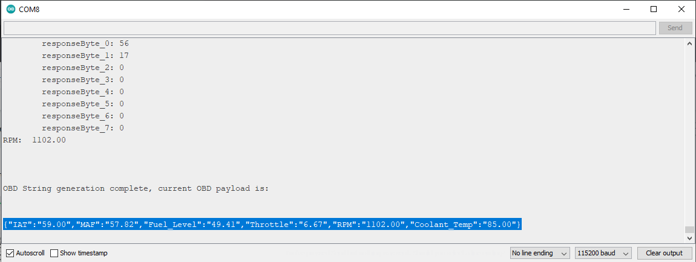
Serial monitor output for OBD parameters

Slide 10
The following slides were used during demo.

Slide 11

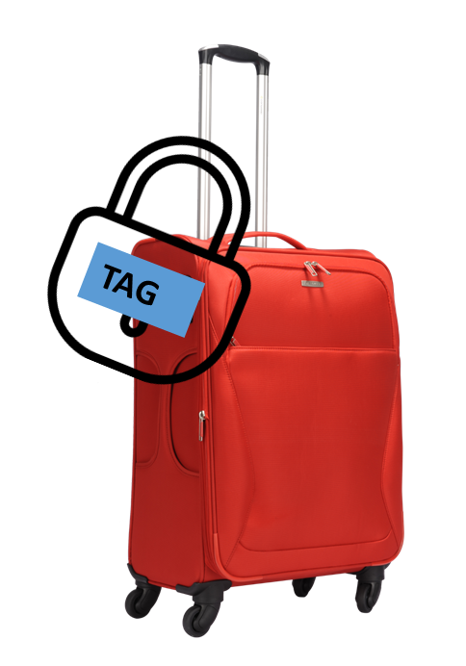




ASSET SECURING SYSTEM
GATEWAY
Lock Status
LOCK STATUS
ASSET STATUS
UNSAFE ASSET’s INFO
ASSET INFO

Slide 12
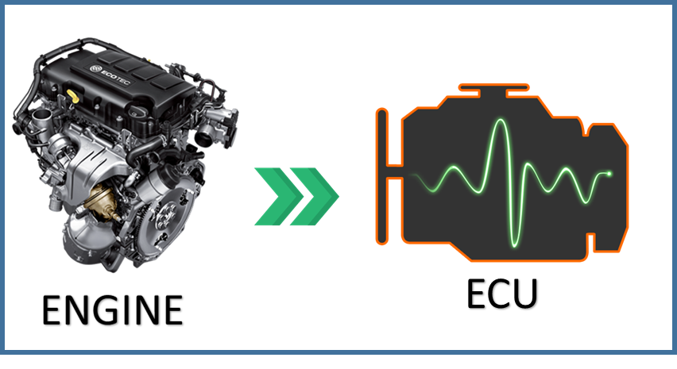

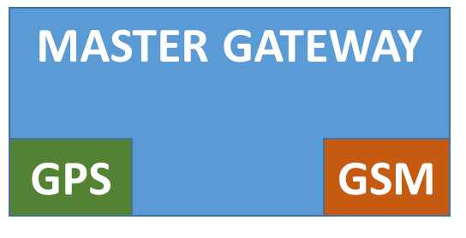



VEHICLE MONITORING SYSTEM
Location
&
Bus Data
Pending OTP
&
Loc SMS info
OBD Parameters
CAN
(Controller Area Network)
Location Coordinates
GNSS
(Global Navigation Satellite System)
OTP
Or
Last Location info

Slide 13
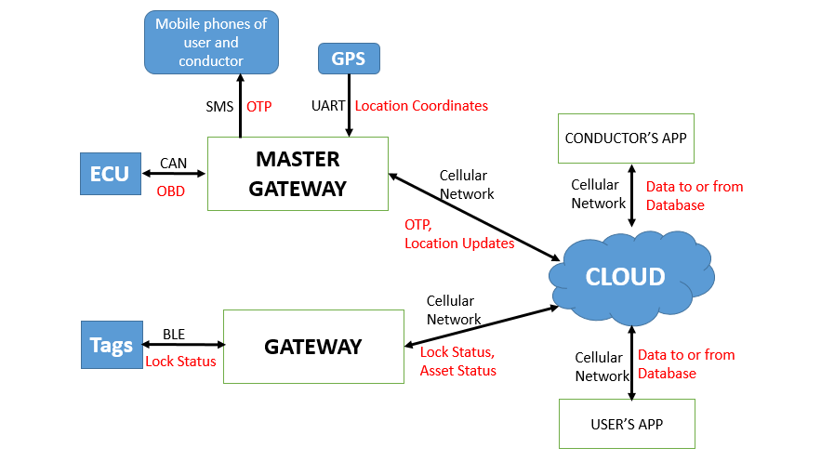
COMPLETE ARCHITECTURE

Slide 14
Check Parameters for Demo
Vehicle Monitoring System:
MongoDB document addition test
MongoDB chart update Test
MongoDB Raw Data check from Serial Monitor{To be performed in car}
Location Update Check
Asset Tracking System:
Addition of entry through User App and Conductor App
Password mismatch check
QR mismatch check
OTP mismatch check
Correct entry check
Logging in the Apps
Forgot Password check
Password mismatch check
Monitoring the Asset status
Safe Condition: Status & Alarm check in Software and Hardware
Unsafe Condition: Status & Alarm check in Software and Hardware
Query and Passenger removal check
Lock/Unlock and status check in Gateway and Tag
Removal of entry through User App and Conductor App
Password mismatch check
Re-login failure after removal check

Slide 15
THANKS

